Slide 1

Introduction
Gandeva Bayu Satrya
gbs@ittelkom.ac.id
gandeva.bayu.s@gmail.com
October 16th 2013
INFORMATICS FACULTY
Telkom Institute of Technology Bandung
Telkom Engineering School

Slide 2
Agenda
Network Type
Network Media
OSI Layer
Subnetting

Slide 3
Network Type
Personal (PAN)
Local (LAN)
Campus (CAN)
Backbone
Metropolitan (MAN)
Wide (WAN)
Internet

Slide 4
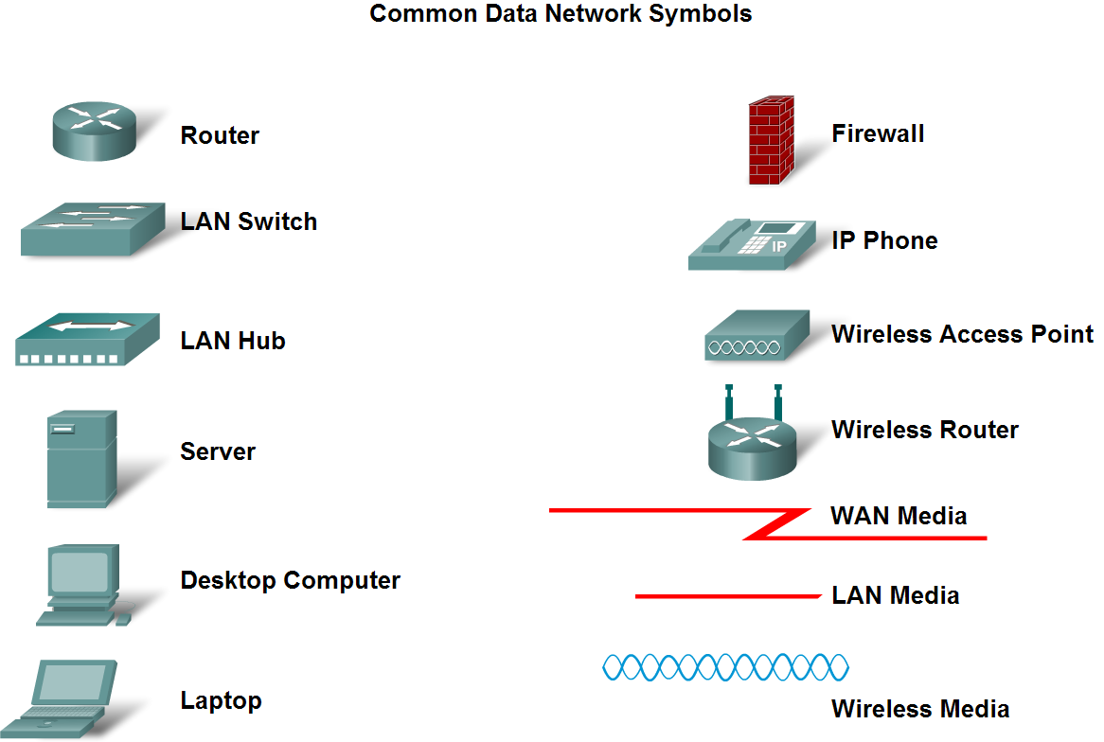
Network Symbols

Slide 5
Agenda
Network Type
Network Media
OSI Layer
Subnetting

Slide 6
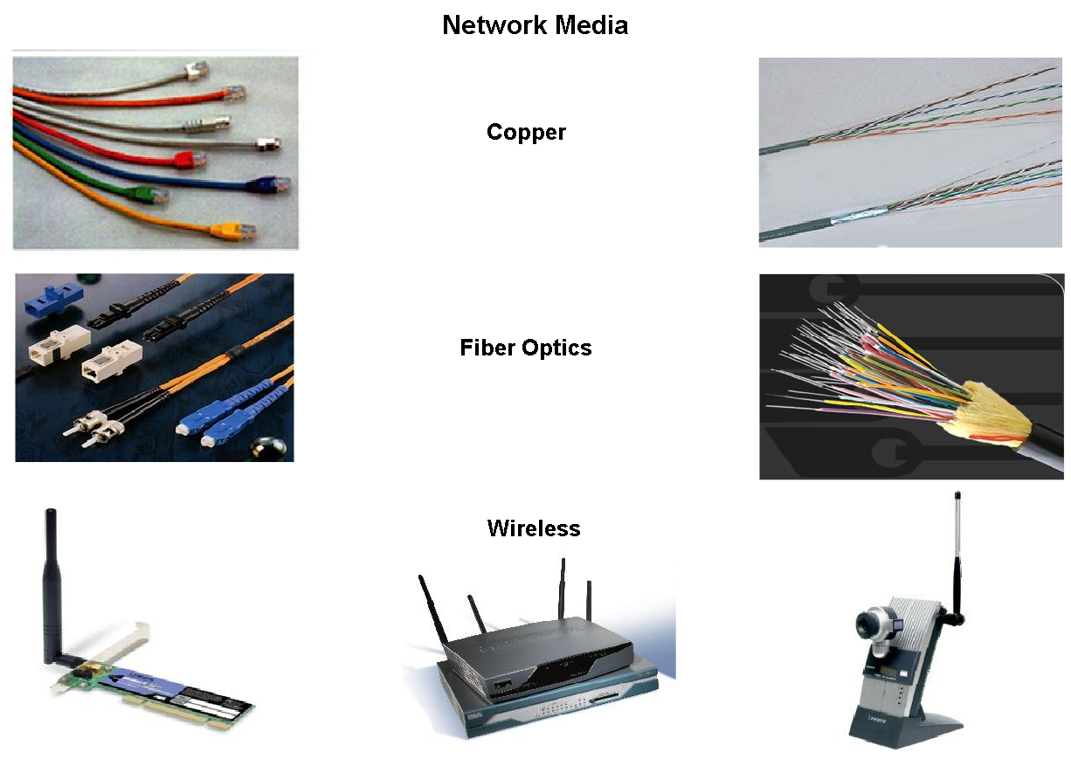
Network Media

Slide 7
Agenda
Network Type
Network Media
OSI Layer
Subnetting

Slide 8
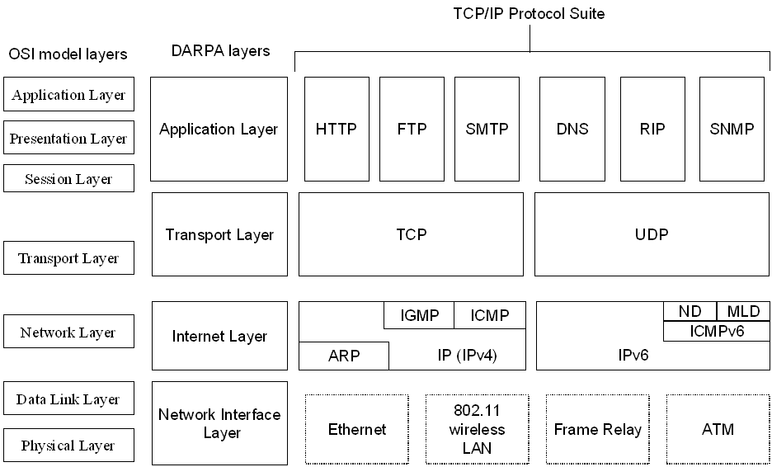
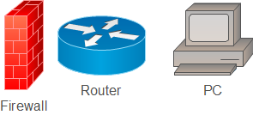
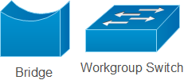

OSI Layers vs TCP/IP Layers

Slide 9
Agenda
Network Type
Network Media
OSI Layer
Subnetting

Slide 10

IP Address in Routing
10.13.0.1
192.168.1.1
HDR
SA
DA
DATA
172.17.0.1
172.17.0.2
Uniquely and logically identify end stations
Packet forwarding is based on IP Address
Notes:
An IP address is an address used to uniquely identify a device on an IP network. The address is made up of 32 binary bits which can be divisible into a network portion and host portion with the help of a subnet mask.

Slide 11
IP Address
32 bits
Network
Host
255
255
255
255
Maximum
1
8
9
16
17
24
25
32
11111111
11111111
11111111
11111111
Binary
Decimal
172
16
122
204
Binary
10101100
00010000
01111010
11001100
Notes:
An IP address is an address used to uniquely identify a device on an IP network. The address is made up of 32 binary bits which can be divisible into a network portion and host portion with the help of a subnet mask.

Slide 12
Classification
8 bits
8 bits
8 bits
8 bits
Class A:
Class B:
Class C:
Class D: Multicast Address
Class E: Reserved for Research
Network
Host
Host
Host
Network
Network
Host
Host
Network
Network
Network
Host
Notes:
An IP address is an address used to uniquely identify a device on an IP network. The address is made up of 32 binary bits which can be divisible into a network portion and host portion with the help of a subnet mask.

Slide 13
Possible Valid Network Numbers
1
8
9
16
17
24
25
32
Bits:
Class A:
0NNNNNNN
Host
Host
Host
Range (1-126)
Class B:
10NNNNNN
Network
Host
Host
Range (128-191)
Class C:
110NNNNN
Network
Network
Host
Range (192-223)
Class D:
1110MMMM
Multicast Group
Multicast Group
Multicast Group
Range (224-239)
Class E:
Reserved for Research
Notes:
An IP address is an address used to uniquely identify a device on an IP network. The address is made up of 32 binary bits which can be divisible into a network portion and host portion with the help of a subnet mask.

Slide 14
Classify and Define IPv4 Addresses
Define public address and private address
The private address blocks are:
10.0.0.0 to 10.255.255.255 (10.0.0.0 /8)
172.16.0.0 to 172.31.255.255 (172.16.0.0 /12)
192.168.0.0 to 192.168.255.255 (192.168.0.0 /16)
Notes:
An IP address is an address used to uniquely identify a device on an IP network. The address is made up of 32 binary bits which can be divisible into a network portion and host portion with the help of a subnet mask.

Slide 15
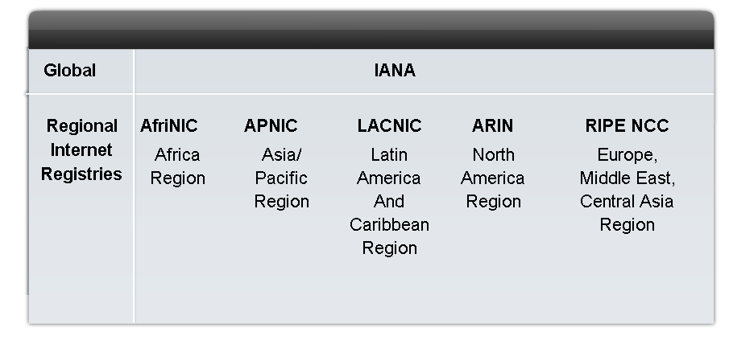
Assigning Addresses
Describe the process for requesting IPv4 public addresses, the role ISPs play in the process, and the role of the regional agencies that manage IP address registries
Notes:
An IP address is an address used to uniquely identify a device on an IP network. The address is made up of 32 binary bits which can be divisible into a network portion and host portion with the help of a subnet mask.

Slide 16
Default Subnet Mask
Class of Address
Size of network part
Size of host part
Default mask
A
8
24
255.0.0.0
B
16
16
255.255.0.0
C
24
8
255.255.255.0
Notes:
An IP address is an address used to uniquely identify a device on an IP network. The address is made up of 32 binary bits which can be divisible into a network portion and host portion with the help of a subnet mask.

Slide 17
Addressing Without Subnets
172.19.0.0
A
172.18.0.0
B
172.16.0.0
172.17.2.0
Subnet mask: 255.255.0.0

Slide 18
Addressing With Subnets
172.16.3.0
A
172.16.4.0
B
172.16.1.0
172.16.2.0
Subnet mask: 255.255.255.0

Slide 19

IP Address Allocation (Subneting)
Easy for management
Whole network principle
Physical place principle
Service principle
Economic use of IP addresses principle
Notes:
An IP address is an address used to uniquely identify a device on an IP network. The address is made up of 32 binary bits which can be divisible into a network portion and host portion with the help of a subnet mask.

Slide 20
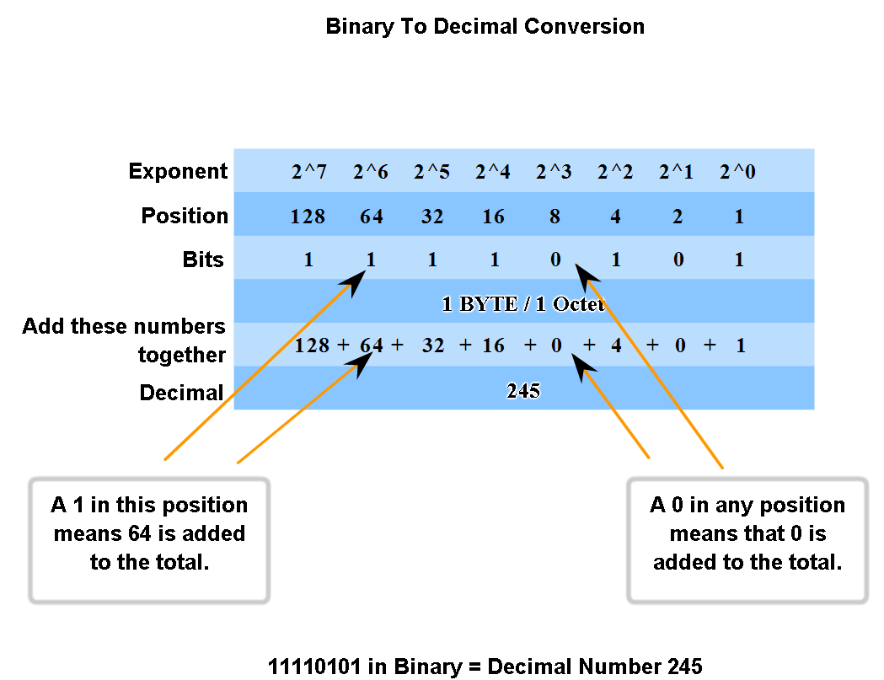
IP Addressing Structure
Practice converting 8-bit binary to decimal
Notes:
An IP address is an address used to uniquely identify a device on an IP network. The address is made up of 32 binary bits which can be divisible into a network portion and host portion with the help of a subnet mask.

Slide 21
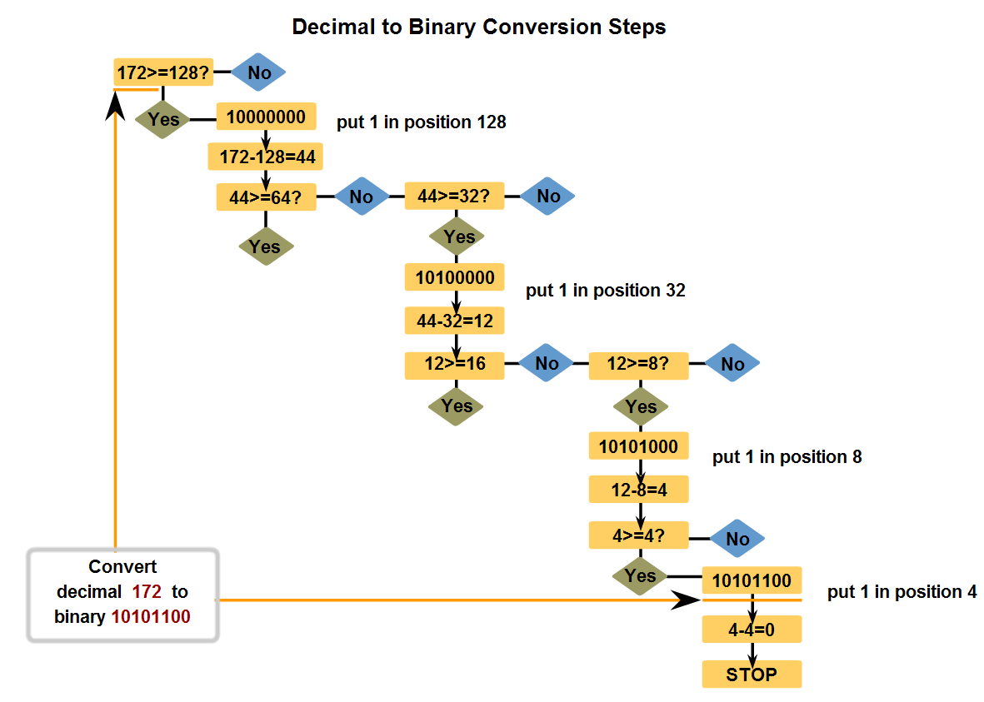
IP Addressing Structure
Convert decimal to 8-bit binary
Notes:
An IP address is an address used to uniquely identify a device on an IP network. The address is made up of 32 binary bits which can be divisible into a network portion and host portion with the help of a subnet mask.

Slide 22
How Many Hosts And Subnets
Process:
Step 1:The class rules define the network part.
Step 2:The mask binary 0s define the host part.
Step 3:What’s left over defines the size of subnet part
Step 4:Number of subnets available=
2^{number-of-bits-1}-2
Step 5:Number of hosts per subnet available=
2^{number-of-bits-0}-2
Notes:
An IP address is an address used to uniquely identify a device on an IP network. The address is made up of 32 binary bits which can be divisible into a network portion and host portion with the help of a subnet mask.

Slide 23
How Many Hosts And Subnets
Address
Subnet Mask
Class
Subnet
BC
GW
201.222.10.60
255.255.255.248
15.16.193.6
255.255.248.0
128.16.32.13
255.255.255.252
153.50.6.27
255.255.255.128
Notes:
An IP address is an address used to uniquely identify a device on an IP network. The address is made up of 32 binary bits which can be divisible into a network portion and host portion with the help of a subnet mask.

Slide 24
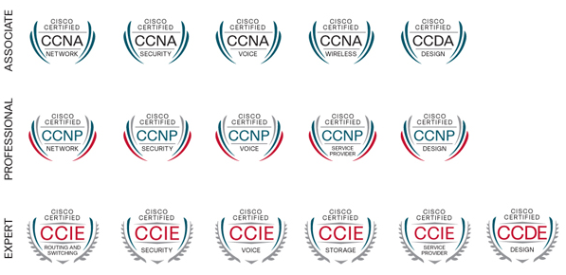
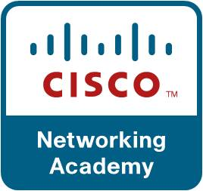
CISCO Certification
Notes:
An IP address is an address used to uniquely identify a device on an IP network. The address is made up of 32 binary bits which can be divisible into a network portion and host portion with the help of a subnet mask.

Slide 25
Thank You
Gandeva Bayu Satrya
gbs@ittelkom.ac.id
gandeva.bayu.s@gmail.com
October 16th 2013
INFORMATICS FACULTY
Telkom Institute of Technology Bandung
Telkom Engineering School

